Slide 1
Radium sorption to iron minerals
Michael Chen, Tiffany Wang, Benjamin Kocar
MIT Department of Civil and Environmental Engineering
AGU Fall Meeting
December 18th, 2015
Notes:
Good morning, my name is Michael Chen, and I’ll be presenting some results from our lab’s work on radium sorption to iron minerals.

Slide 2
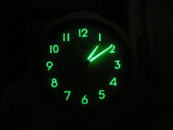
Introduction and objectives
Naturally occurring radium isotopes
Natural hazard/tracer with little human use
Wide range of half lives
3 days – 1600 years
2 oxidation states
Goal: Understand geochemistry for better predictions of transport
This talk: Behavior in static systems
Clock using radium for illumination from en.Wikipedia.org/Radium_dials

Slide 3
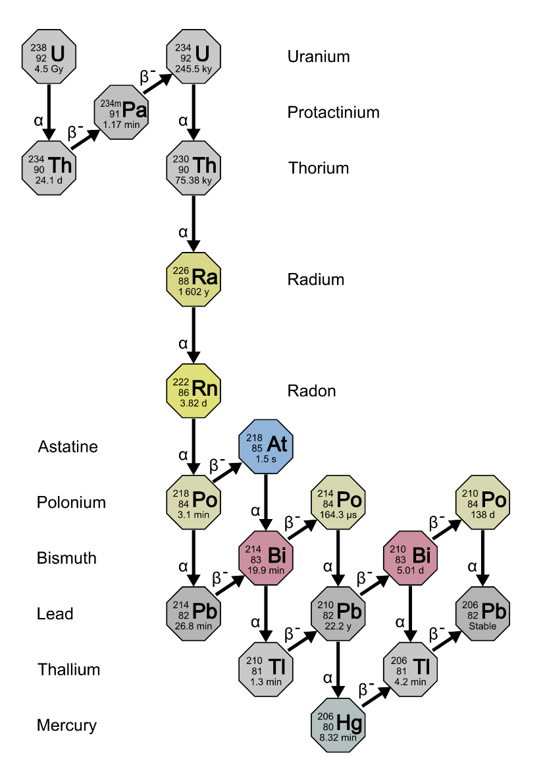
Radium in the environment
Source: ubiquitous parent radionuclides
Activities: ~0.2 DPM/L
EPA Drinking Limit: 11.1 DPM/L
Removal dominated by advection and decay
Extensive adsorption to oxidized iron and manganese minerals
Changing environmental conditions affect transport
Salinity
Redox potential
pH
Uranium Series decay taken from en.Wikipedia.org/Decay_chain

Slide 4
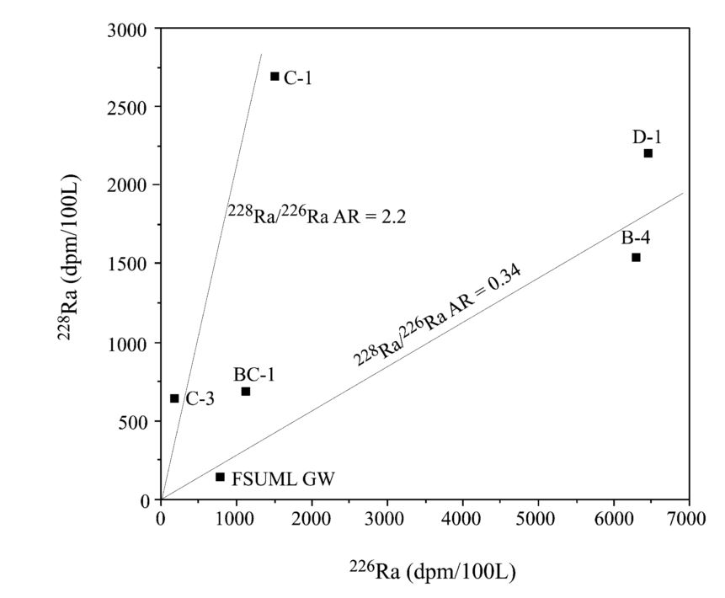
Radium as groundwater flux tracer
Radium isotope mixing model for nearshore system
Source:
Groundwater
Sink:
Decay
Assumes conservative transport of isotopes
Figure adapted from Moore, 2003, illustrating the identification of radium sources for a nearshore system.

Slide 5
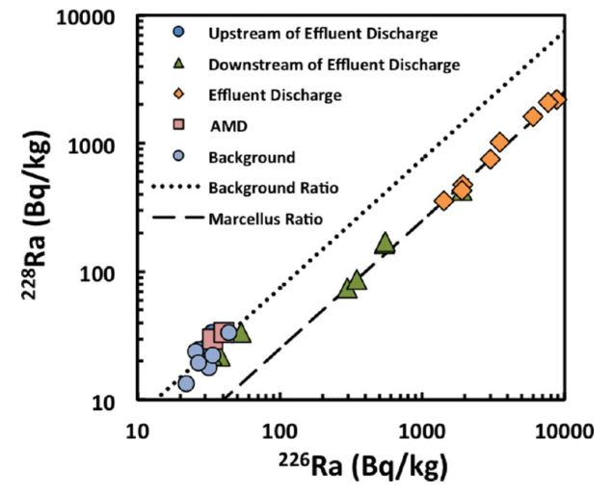
Radium in hydraulic fracturing
Produced water brings radium to surface
Activities: >5000 DPM/mL
Alteration in-situ redox state
Treatment/disposal expensive
Co-precipitation with Barium Sulfate
Improper handling can lead to leakage
Potential to mark contamination events
Figure from Warner et al, 2013 of river sediment radium concentrations near a waste water treatment plant

Slide 6
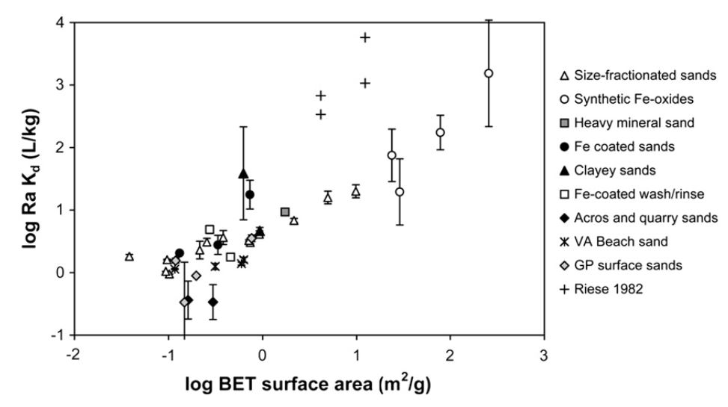
“Historical” data: large variability
DATA SLIDE
Radium sorption to marine sands in seawater from Beck & Cochran, 2013

Slide 7
Central Questions
What are the dominant minerals that retain radium?
How do solution conditions affect radium transport?
How does radium retention change when redox reactions alter mineralogy?
Notes:
Maybe tune this

Slide 8
Experimental Work
Sorption Isotherms
Static (no flow) experiments
Redox alteration
pH envelopes

Slide 9
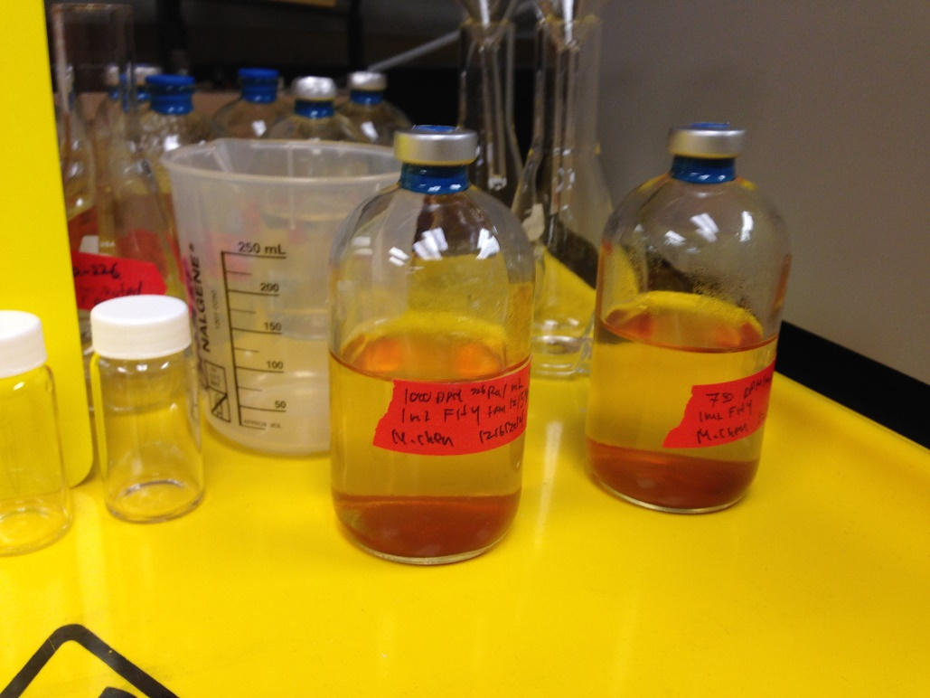
Static Condition Methodology
Synthesized Ferrihydrite, 8 mg in solution
Acid washed, 44-250 um pyrite, 20 mg
3000 to 50000 DPM total activity
24 hour shaking time with 100 mL pH adjusted 18 MΩ water
Radium 226 counted with scintillation counter
Two serum vials after a sorption isotherm experiment

Slide 10
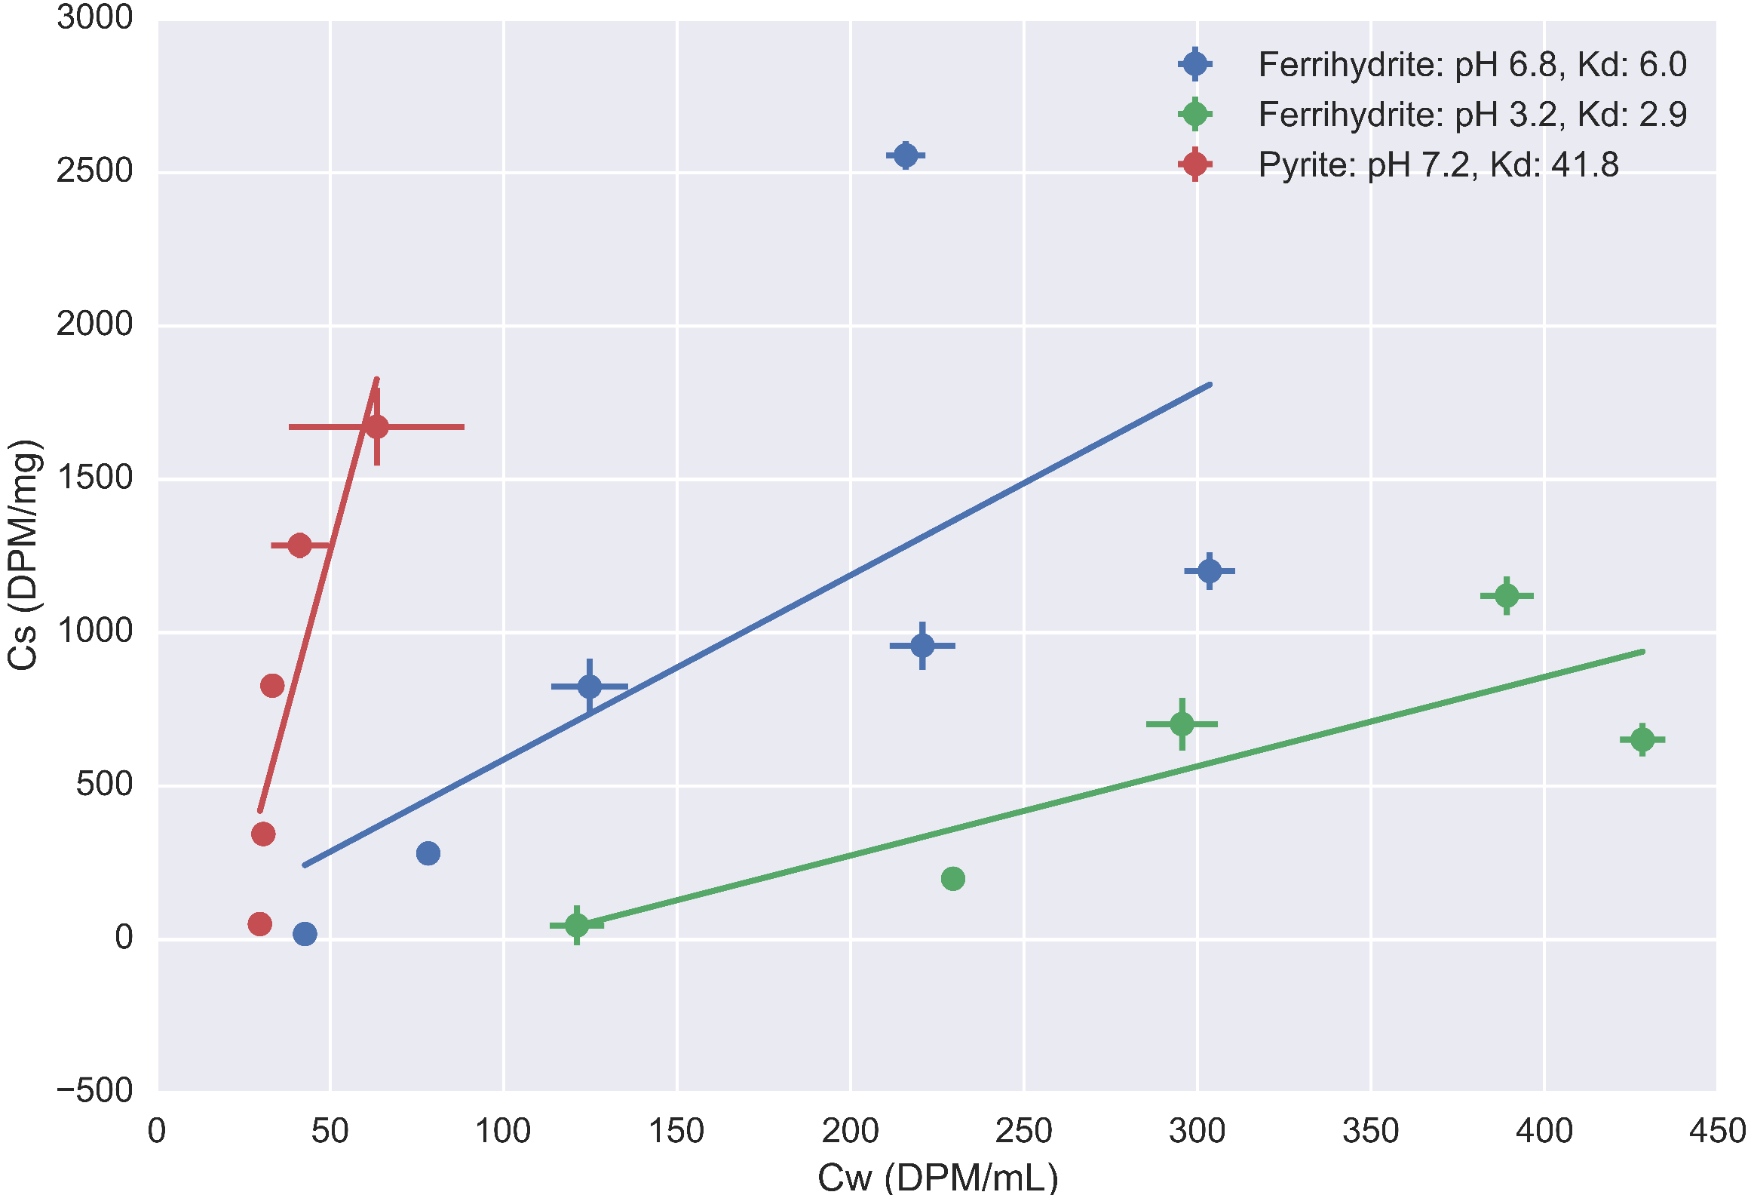

Slide 11
Isotherm discussion
Results
Ferrihydrite: Low pH has lower sorption
Pyrite: Stronger adsorption than ferrihydrite at same pH
Data points in need of clarification
Implications
Ferrihydrite generally sorbs more extensively
Oxidation of pyrite->desorption of sorbed radium
Need to identify other controlling sorbents

Slide 12
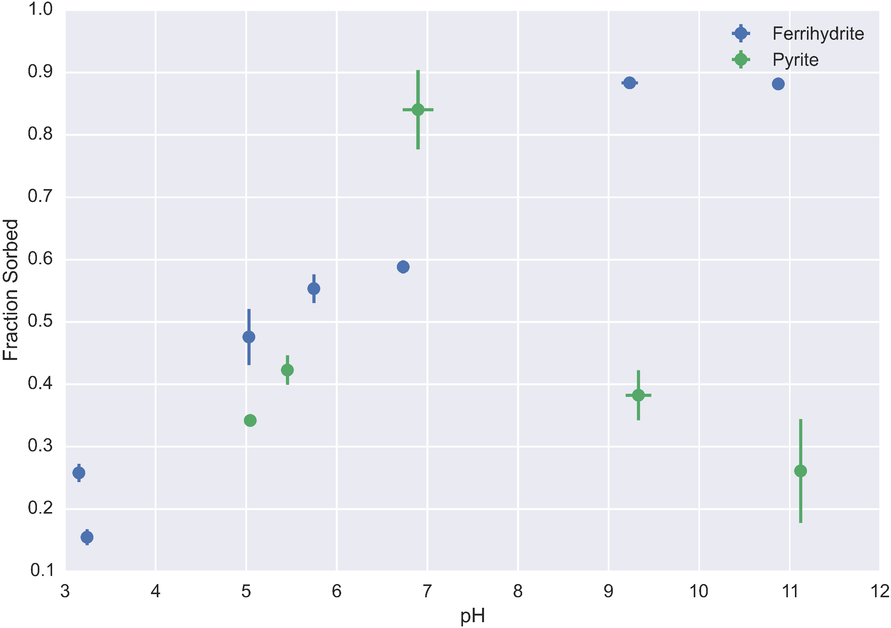

Slide 13
Discussion
Results
Ferrihydrite:
Increasing adsorption with increasing pH, matching isotherm results
Adsorption peaks out
Pyrite:
Maximal sorption at circumneutral pH
Implications
Control pH to control sorption
Mineral specific behavior

Slide 14

Oxidation Experiment Methodology
Pyrite experiment after shaking period
Removal of supernatant for quantification
Addition of 3% hydrogen peroxide
Shaking for 48 hours
Schematic where a pyrite grain is oxidized, forming oxidized iron coatings and potentially releasing radium from the surface

Slide 15
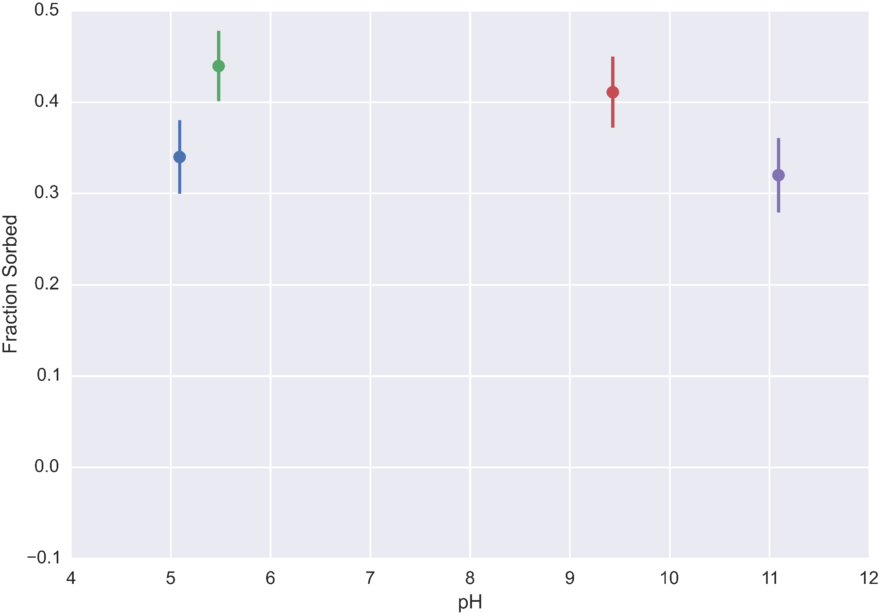
Oxidation Experiment: Before addition of hydrogen peroxide

Slide 16
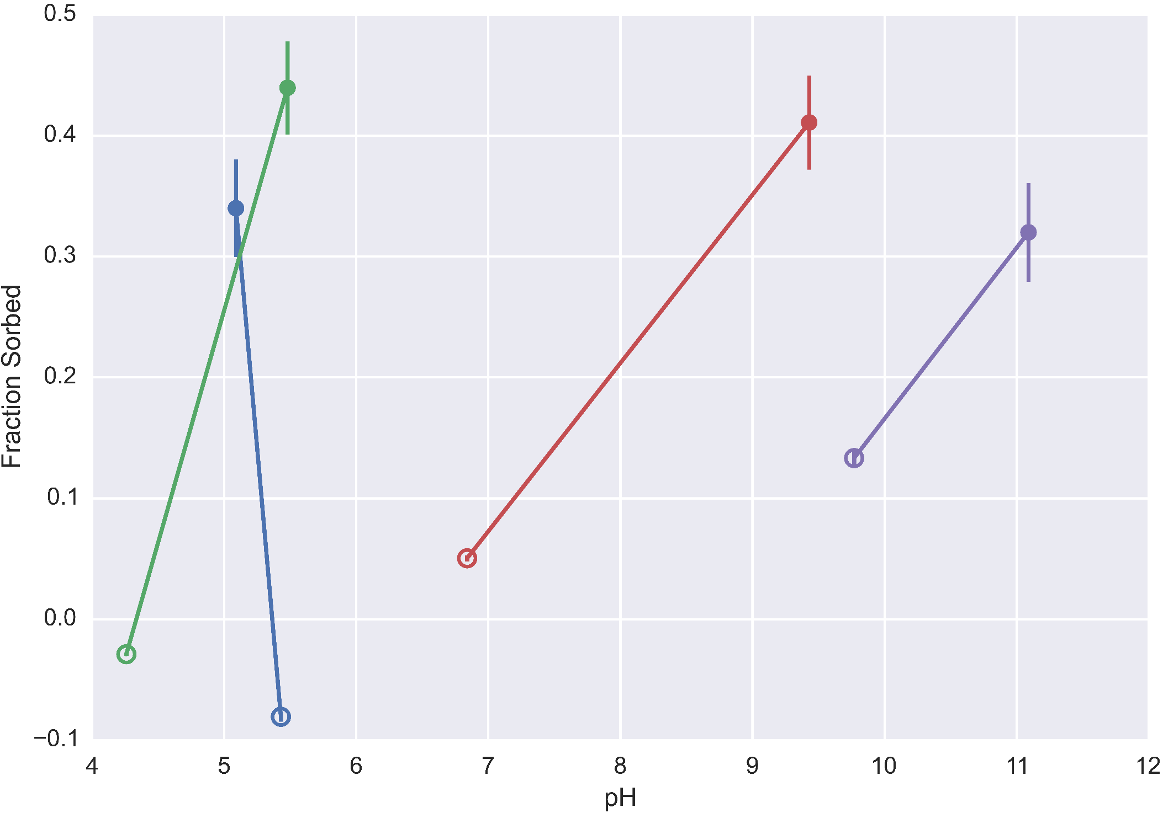
Oxidation Experiment: After hydrogen peroxide addition

Slide 17
Oxidation Experiment: After hydrogen peroxide addition
Radium and Pyrite
Oxidized Pyrite
Notes:
Remember to talk about control, need to rerun this agian

Slide 18
Discussion
Results
Overall decrease in sorption
More desorption with oxidant than without
Decrease in pH->change in sorption, oxidation of pyrite
Implications
Oxidation of reduced minerals induces desorption
Ideal retention conditions depend on redox state

Slide 19
Conclusions
Quantified pyrite and ferrihydrite sorption behavior
Radium sorbs more extensively to pyrite than ferrihydrite
Minerals have pH dependent behavior
Sensitive partitioning behavior
Strong dependence on mineral
Flux of oxic solution into anoxic system can induce radium release
Control solution chemistry to enhance retention

Slide 20
Future work
Further sorption experiments (competing ions, minerals)
Transport experiments
Impact of dynamic solution conditions

Slide 21
Acknowledgements
MIT Radiation Protection Office
Roman Stocker, Roberto Rusconi
Kocar Lab
SSRL

Slide 22
Works Cited
Beck, A. J., & Cochran, M. a. (2013). Controls on solid-solution partitioning of radium in saturated marine sands. Marine Chemistry, 156, 38–48. doi:10.1016/j.marchem.2013.01.008
Moore, W. S. (2003). Sources and fluxes of submarine groundwater discharge delineated by radium isotopes. Biogeochemistry, 66(1), 75–93. doi:10.1023/B:BIOG.0000006065.77764.a0
Warner, N. R., Christie, C. a., Jackson, R. B., & Vengosh, A. (2013). Impacts of shale gas wastewater disposal on water quality in Western Pennsylvania. Environmental Science and Technology, 47, 11849–11857. doi:10.1021/es402165b
Wikipedia. (2014, November 21). Retrieved from https://en.wikipedia.org/

Slide 23
Natural Backgrounds
Note that some natural sources of water exceed the EPA defined drinking water limit (Iowa well water nearly 60 DPM/L in some places)

Slide 24
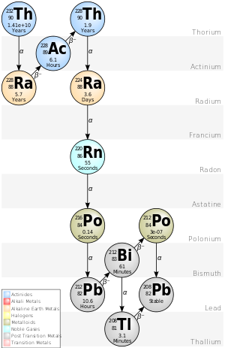

Slide 25
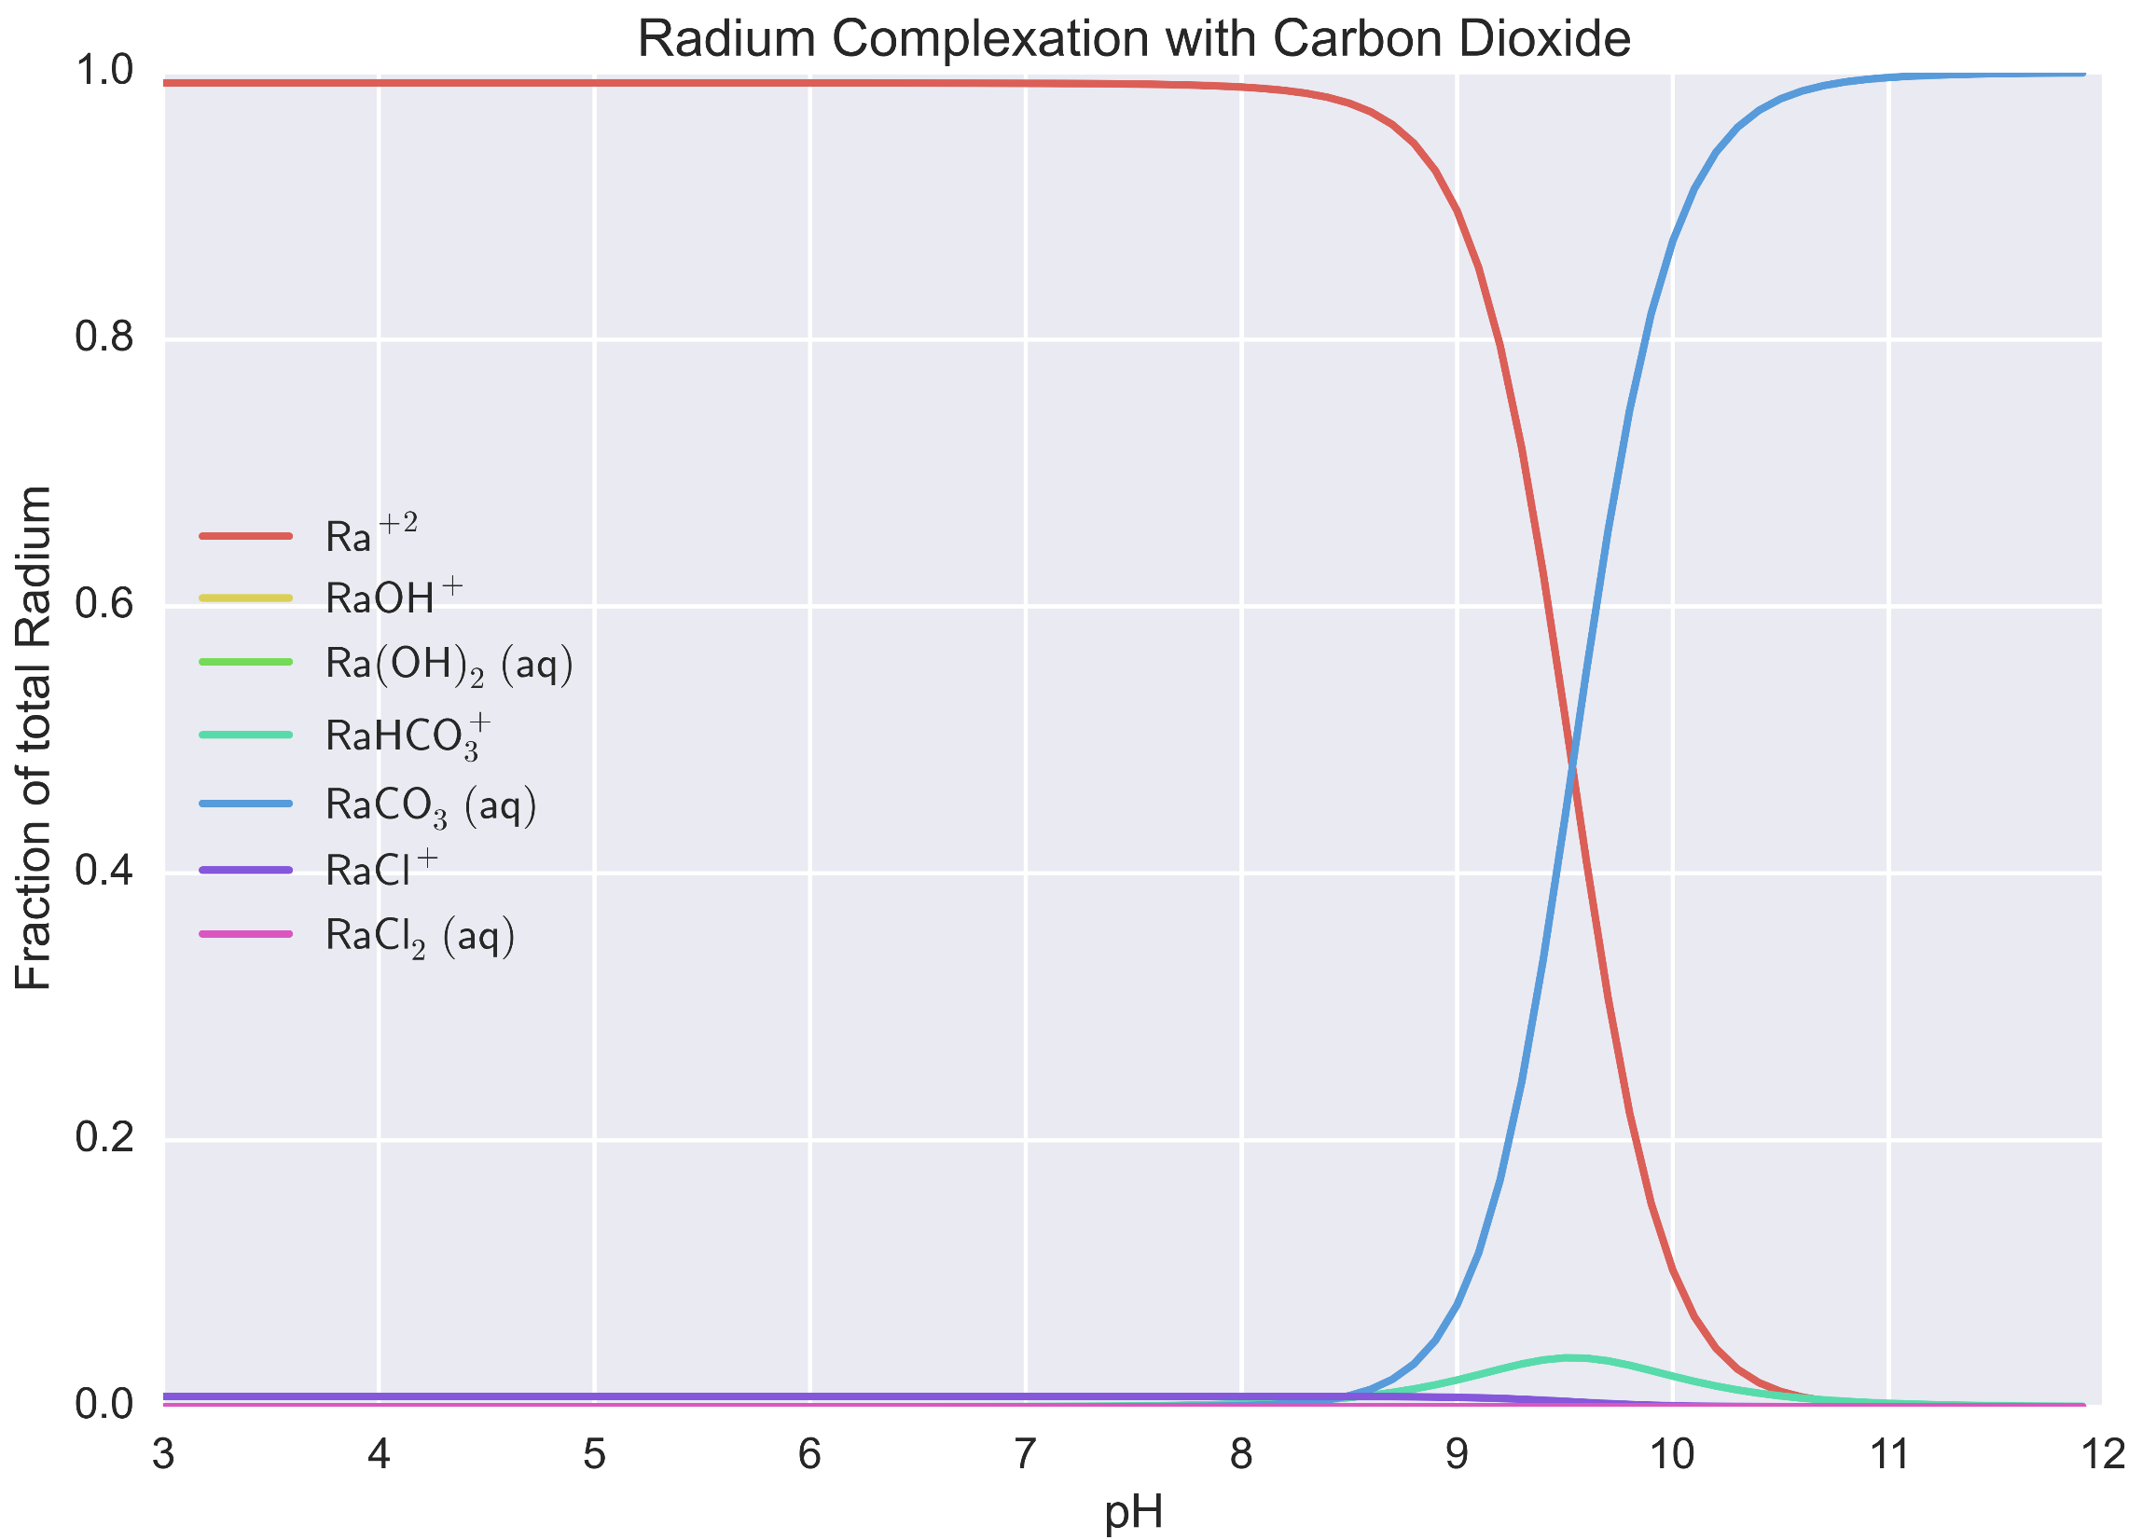

Slide 26
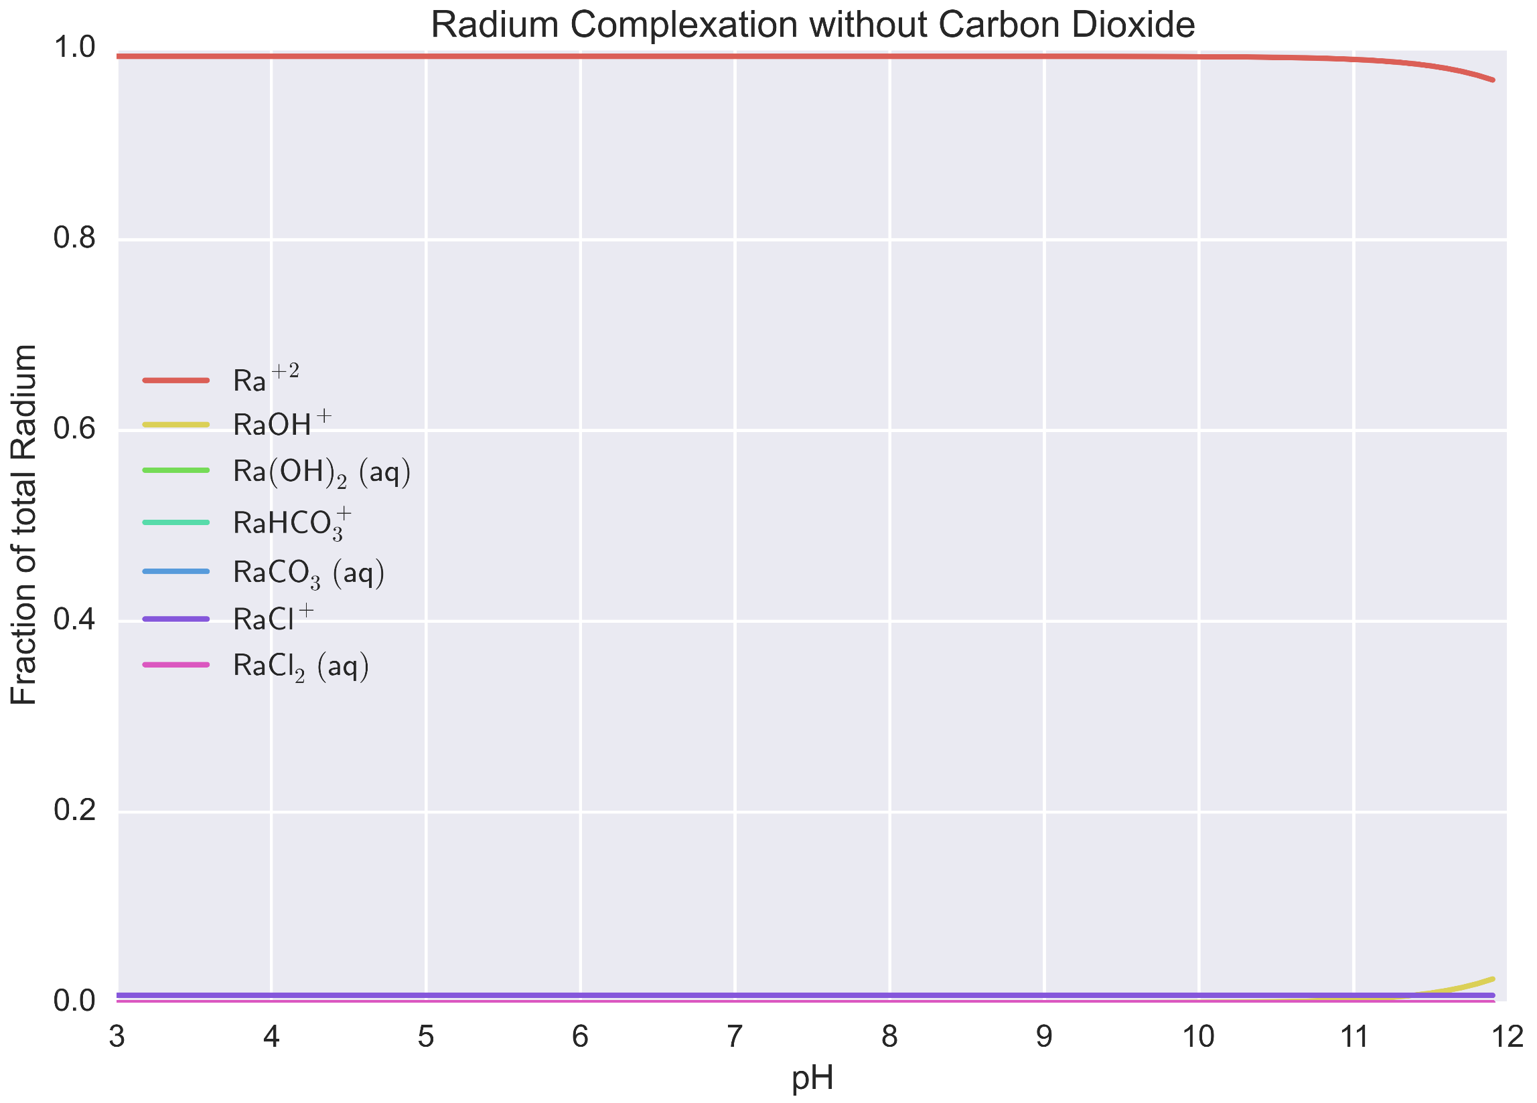

Slide 27
Things to add
Solid hazard limits? Unclear, Superfund documents (Radium Chemical, NY, 1990 ROD) set 11 DPM/g soil at surface, 33 DPM/g in subsurface
Is effluent release a hazard? Seems the sediments downstream are above this documented Superfund level (corresponds to roughly 200 Bq/kg)
Biological chain effects (biomagnification)?
Go through Scwertman (not recipes) for iron oxide background (pH ranges, natural conditions, stability)
PZC curves for minerals of interest
Surface complexation of radium (inner/outer sphere) (Sajih + sources) (surface compl. Of barium)
How hard is radium (lewis base basis)?
What is the complexation behavior vs surface behavior of Calcium/Barium/Strontium
What actually forms when pyrite oxidizes?
Composition of shales

